Slide 1

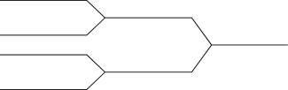

PATRICIA
TRIE

Slide 2
OUR TEAM
Sr. No. | Roll No. | Name
1 | 222012 | Dimpal Bhorkar
2 | 222013 | Karan Chavan
3 | 222014 | Parth Chavan
4 | 222016 | Vaishnavi Desai
5 | 222018 | Vinit Deshmukh
.

Slide 3
What is Trie
A trie, or prefix tree, is “a data structure built from the characters of the search key to guide the search”. This “data structure is composed of nodes that contains links that are either null or reference to other nodes. Each node is pointed to by just one other node, which is called its parent (except for one node, the root, which has no nodes pointing to it), and each node has S links, where S is the alphabet size (or charset)”.

Slide 4
Patricia Trie
A Patricia Trie or prefix Tree or radix Tree is an ordered structured tree, which takes the applications of usually the data it stores.
A node’s position in the tree defines the key with which that node is associated, which makes tries different in comparison to binary search Trees, in which a node stores a key that corresponds only to that node.
Each node has one prefix which is a string while the other one is an empty String.

Slide 5
General Operations of Patricia trie
Insert
Search
Delete

Slide 6
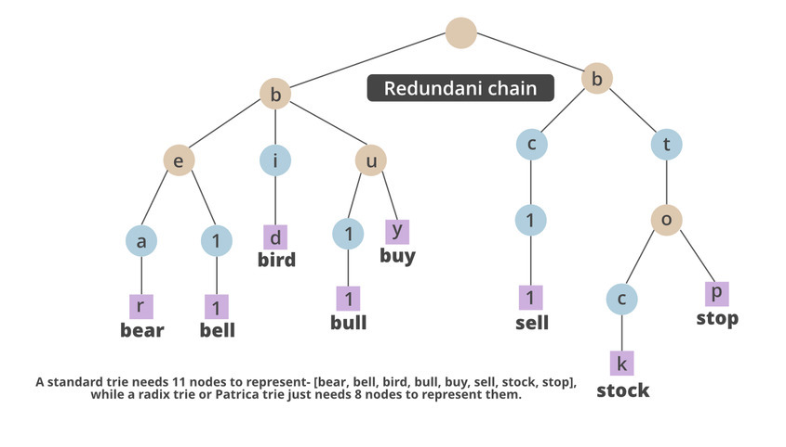

Slide 7
Algorithm
create a class PatriciaTrieNode, in which we declare all the variables of the class.
declare another PatriciaTest, where we build the PatriciaTest constructor.
declare functions like makeEmpty() or isEmpty() to check the Node’s status.
declare the function bit, which will help us to store the element in the node.
write a function Boolean search which will help to find if the element is there in the Node.
PatriciaTrieNode search is a function to search for an element.
create a function insert PatriciaTrieNode.
declare the main class.

Slide 8
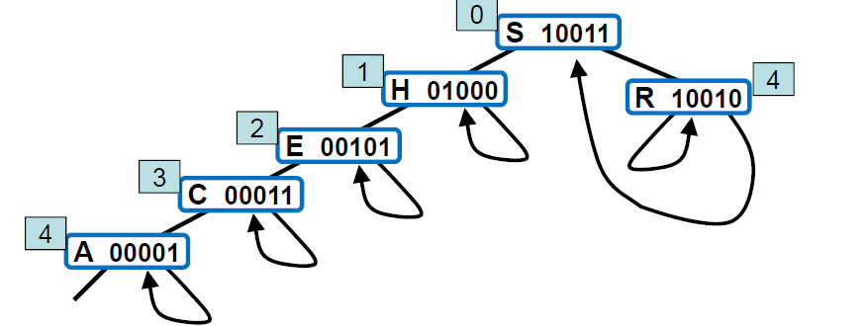
EXAMPLE
In a successful search for R = 10010 in this sample patricia trie (top), we move right (since bit 0 is 1), then left (since bit 4 is 0), which brings us to R (the only key in the tree that begins with 1***0). On the way down the tree, we check only the key bits indicated in the numbers over the nodes (and ignore the keys in the nodes). When we first reach a link that points up the tree, we compare the search key against the key in the node pointed to by the up link, since that is the only key in the tree that could be equal to the search key.

Slide 9
Applications
Radix trees are useful for constructing associative arrays with keys that can be expressed as strings.
They find particular application in the area of IP routing, where the ability to contain large ranges of values with a few exceptions is particularly suited to the hierarchical organization of IP addresses.
They are also used for inverted indexes of text documents in information retrieval.

Slide 10
THANK
YOU

